Slide 1



Weekly Meeting
Liri Chen, Shuo Lin, Wenqi Sun, Zhexin Wang, Zixiao Zhang

Slide 2
Aligned Timeline
Time | Milestone | Status
Oct 3 - Oct 17 | Baseline, metrics | Done
Oct 18 - Oct 31 | Data Retrieval Optimization UI Design | Mostly done. More optimization needed for Image & Caption & Table part
Nov 1 - Nov 21 | Prototype & demo(Search w/o GPT + WebApp) Data Retrieval Integration & Optimization
Nov 22 - Nov 28 | Backend API & UI design
Nov 29 - Dec 16 | Final Presentation

Slide 3
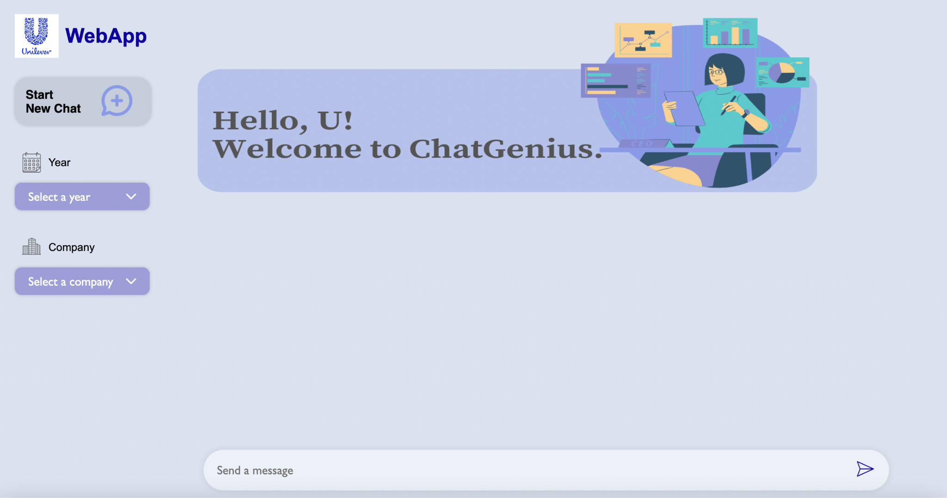
UI

Slide 4
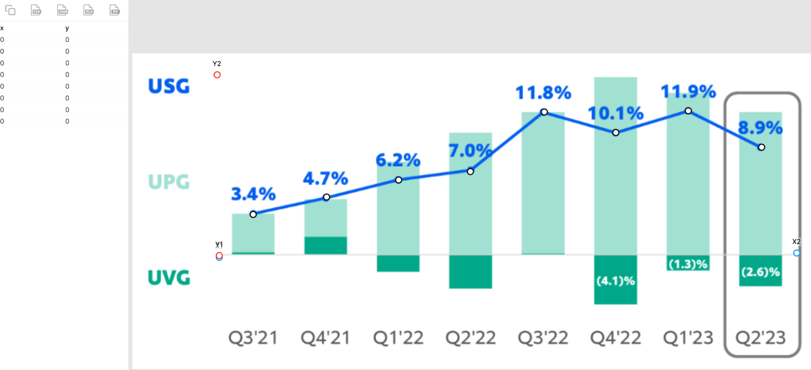
PlotdDigitizer
ChartReader & ChartOCR: GPU required
https://github.com/ShubhamMehla3/graph-ocr/blob/main/run_seq_labeling.py
Some customized codes are not runnable and have a lot of redundant dependencies.

Slide 5
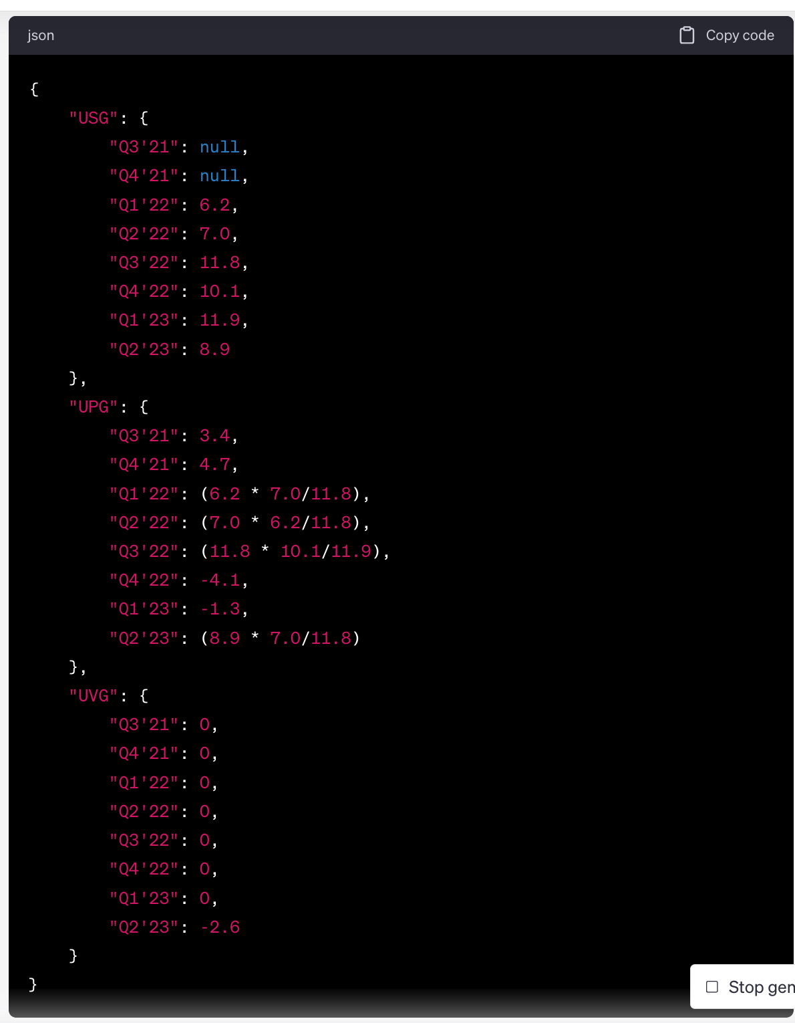
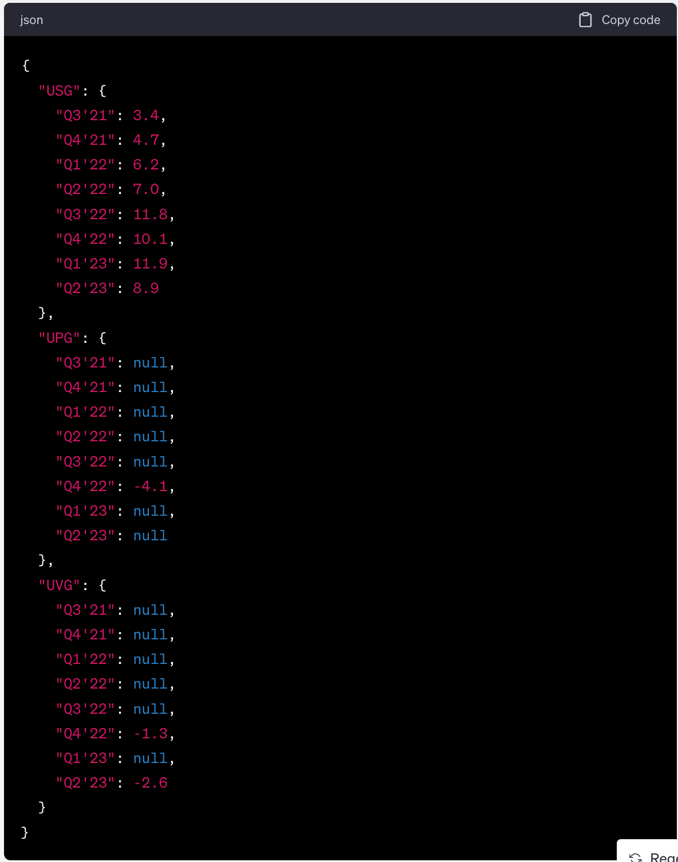
Notes:
ST- forecast methods
Extract the data from this image and export it in the format of JSON, with the following requirements:
1. The blue plot curve is USG data.
2. Estimate the UPG (shallow green) and UVG data (dark green) based on their heights in proportion to the blue plot curve if the data is not given.
3. The data value is positive when the bar is above x-axis, and it is negative when below x-axis.
Extract the data from this image and export it in the format of JSON, with the following requirements: 1. The blue plot curve is USG data, all exist. 2. If no data in the UPG (shallow green) and UVG data (dark green) just output null. 3. The data value is positive when the bar is above x-axis, and it is negative when below x-axis.

Slide 6
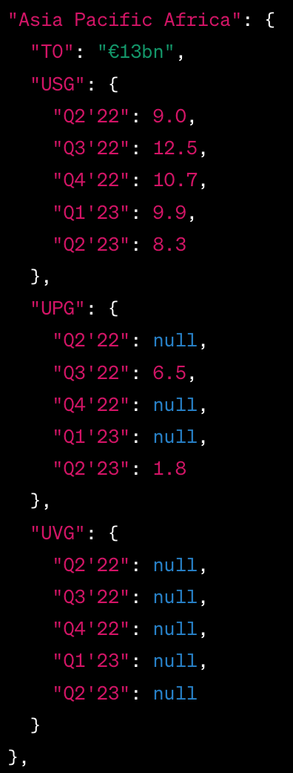
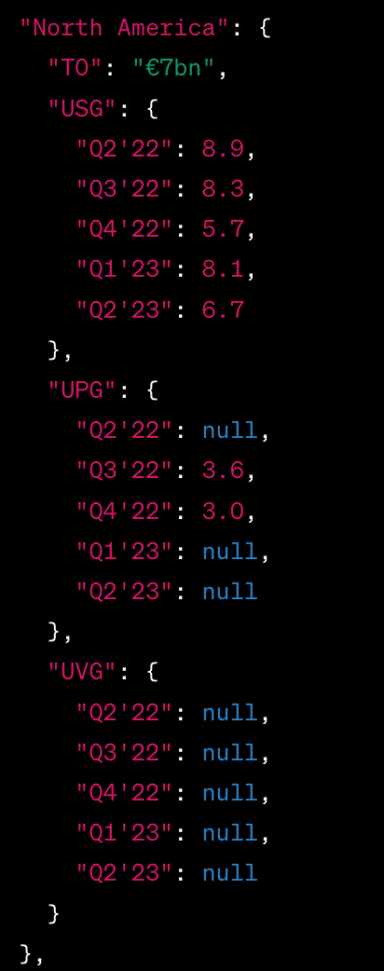
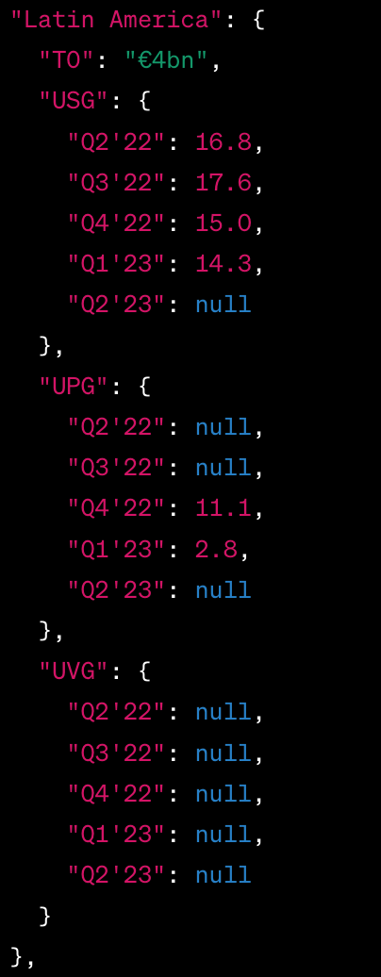
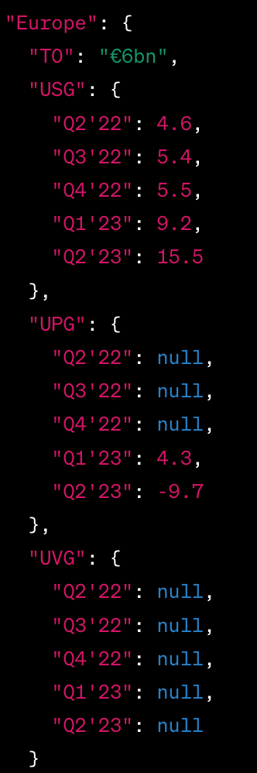
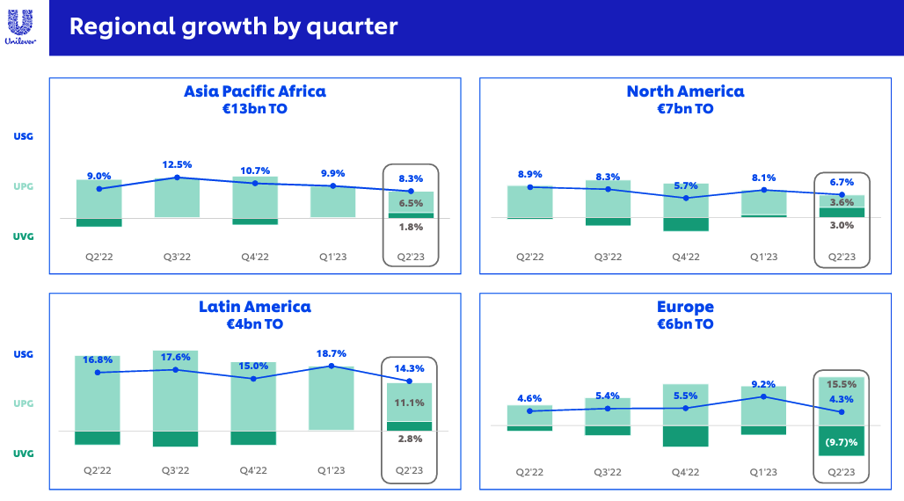

Slide 7
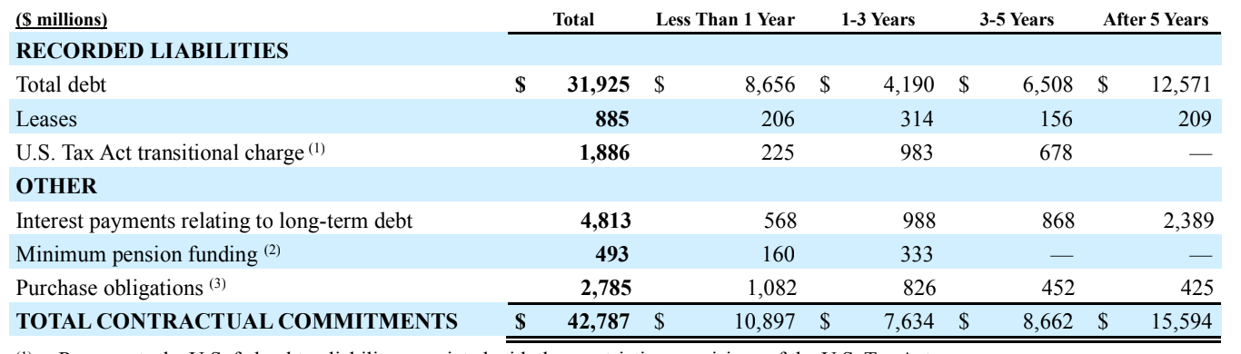
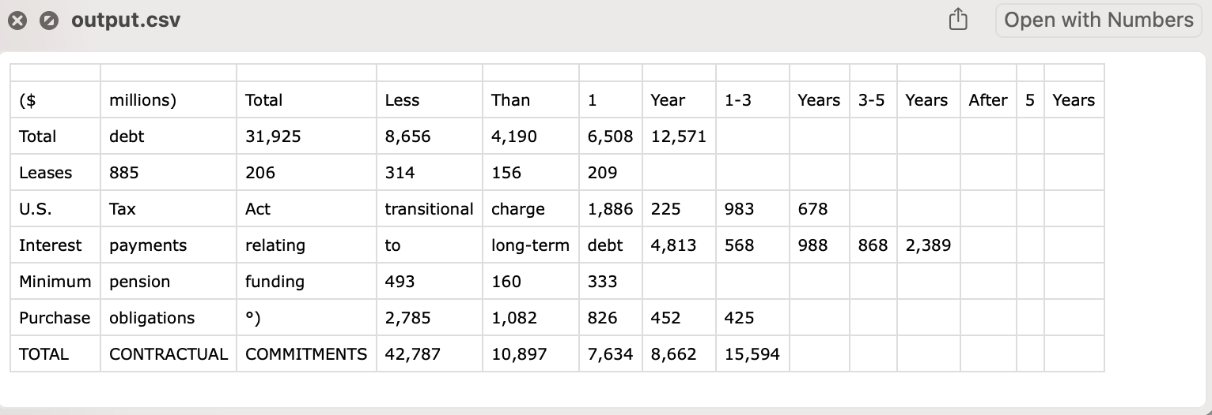
Table Retrieval
Manual Screenshot

Slide 8
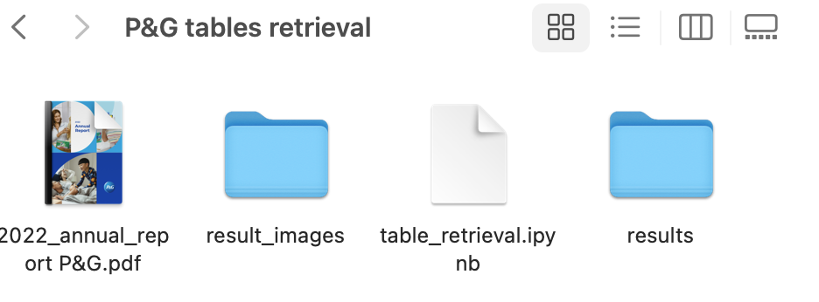
Table Retrieval
Problems:
Blurry images extracted by PyMuPDF (unable to process with pytesseract)
Headers being cut off
The columns/header in the table are not distinctly separated when saved to the CSV file.

Slide 9
Data Retrieval Integration Plan
For each part, we will design a method to take a pdf as input, write the result into disks.
The file structure should be
result/{pdf_name}/{page}/{table|image|chart}/{file}
We use csv for tables, JSON+PNG/JPG for image & charts
E.g. result/unilever_2023/1_table_some_table.csv result/unilever_2023/1_image_some_image.png, result/unilever_2023/1_image_caption.json

Slide 10
Discussions
For the image retrieval part, GPU resources may be needed to run the code faster(for a single page, GPU can accelerate ~10x, tested on P&G report).
For unilever reports, should we still run codes on our local machine?

